Slide 1
Chapter 5a: CPU Scheduling

Slide 2
Chapter 5a: CPU Scheduling
Basic Concepts
Scheduling Criteria
Scheduling Algorithms
Thread Scheduling
Multiple-Processor Scheduling
Real-Time CPU Scheduling
Operating Systems Examples
Algorithm Evaluation

Slide 3
Objectives
To introduce CPU scheduling, which is the basis for multiprogrammed operating systems
To describe various CPU-scheduling algorithms
To discuss evaluation criteria for selecting a CPU-scheduling algorithm for a particular system
To examine the scheduling algorithms of several operating systems

Slide 4

Basic Concepts
Maximum CPU utilization obtained with multiprogramming
Most processes exhibit the following behavior:
CPU burst followed by I/O burst
CPU–I/O Burst Cycle – Process execution consists of a cycle of CPU execution and I/O wait
CPU burst distribution is of main concern

Slide 5

Histogram of CPU-burst Times

Slide 6
CPU Scheduler
Whenever the CPU becomes idle, the operating system must select one of the processes in the ready queue to be executed.
The selection process is carried out by the CPU scheduler.
The ready queue may be ordered in various ways.
CPU scheduling decisions may take place when a process:
  1. Switches from running state to waiting state
  Switches from running state to ready state
  Switches from waiting state to ready state
  When a process terminates
For situations 1 and 4, there is no choice in terms of scheduling. A new process (if one exists in the ready queue) must be selected for execution.
There is a choice, however, for situations 2 and 3.

Slide 7
Nonpreemptive Scheduling
Once the CPU has been allocated to a process, the process keeps the CPU until it releases the CPU:
  either by terminating
  or by switching to the waiting state.

Slide 8
Preemptive scheduling
Preemptive scheduling can result in race conditions when data are shared among several processes.
  Consider the case of two processes that share data. While one process is updating the data, it is preempted so that the second process can run. The second process then tries to read the data, which are in an inconsistent state.
  Consider preemption while in kernel mode
  Consider interrupts occurring during crucial OS activities
Virtually all modern operating systems including Windows, Mac OS X, Linux, and UNIX use preemptive scheduling algorithms.

Slide 9
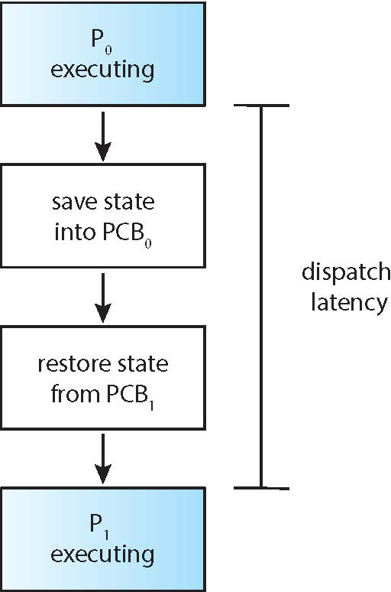
Dispatcher
Dispatcher module gives control of the CPU to the process selected by the CPU scheduler; this involves:
  Switching context
  Switching to user mode
  Jumping to the proper location in the user program to restart that program
Dispatch latency – time it takes for the dispatcher to stop one process and start another running

Slide 10
Scheduling Criteria
CPU utilization – keep the CPU as busy as possible
Throughput – number of processes that complete their execution per time unit (e.g., 5 per second)
Turnaround time – amount of time to execute a particular process
Waiting time – total amount of time a process has been waiting in the ready queue
Response time – amount of time it takes from when a request was submitted until the first response is produced, not output (for time-sharing environment)

Slide 11
Optimization Criteria for Scheduling
Max CPU utilization
Max throughput
Min turnaround time
Min waiting time
Min response time

Slide 12
Scheduling Algorithm
First –come, First-serve (FCFS)
Shortest-Job-First Scheduling (SJF)
Round-Robin Scheduling (RR)
Priority Scheduling
Multilevel Queue Scheduling

Slide 13

First- Come, First-Served (FCFS) Scheduling
Consider the following three processes and their burst time
Process Burst Time
P₁ 24
P₂ 3
P₃ 3
Suppose that the processes arrive in the order: P₁ , P₂ , P₃
We use Gantt Chart to illustrate a particular schedule
Waiting time for P₁ = 0; P₂ = 24; P₃ = 27
Average waiting time: (0 + 24 + 27)/3 = 17

Slide 14

FCFS Scheduling (Cont.)
Suppose that the processes arrive in the order:
P₂ , P₃ , P₁
The Gantt chart for the schedule is:
Waiting time for P₁ = 6; P₂ = 0; P₃ = 3
Average waiting time: (6 + 0 + 3)/3 = 3
Much better than previous case
Convoy effect - short process behind long process
  Consider one CPU-bound and many I/O-bound processes

Slide 15
Shortest-Job-First (SJF)
Associate with each process the length of its next CPU burst
  Use these lengths to schedule the process with the shortest time
SJF is optimal – gives minimum average waiting time for a given set of processes
  How do we know what is the length of the next CPU request
  Could ask the user
    What if the user lies?

Slide 16

Example of SJF
Consider the following four processes and their burst time
ProcessArriva l Time Burst Time
P₁ 0.0 6
P₂ 2.0 8
P₃ 4.0 7
P₄ 5.0 3
SJF scheduling chart
Average waiting time = (3 + 16 + 9 + 0) / 4 = 7

Slide 17


Determining Length of Next CPU Burst
Can only estimate (predict) the length – in most cases should be similar to the previous CPU burst
  Pick the process with shortest predicted next CPU burst
Can be done by using the length of previous CPU bursts, using exponential averaging
Commonly, α set to ½

Slide 18
Examples of Exponential Averaging
α =0
  τ_{n+1} = τ_{n}
  Recent history does not count
α =1
  τ_{n+1} = α t_{n}
  Only the actual last CPU burst counts
If we expand the formula, we get:
    τ_{n+1} = α t_{n}+(1 - α)α t_{n} ₋₁ + …
    +(1 - α )^{j} α t_{n} _{-j} + …
    +(1 - α )^{n +1} τ₀
Since both α and (1 - α) are less than or equal to 1, each successive term has less weight than its predecessor

Slide 19

Prediction of the Length of the Next CPU Burst

Slide 20

Shortest-remaining-time-first
Preemptive version of SJF is called shortest-remaining-time-first
Example illustrating the concepts of varying arrival times and preemption.
ProcessA arri Arrival TimeT Burst Time
P₁ 0 8
P₂ 1 4
P₃ 2 9
P₄ 3 5
Preemptive SJF Gantt Chart
Average waiting time = [(10-1)+(1-1)+(17-2)+5-3)]/4 = 26/4 = 6.5 msec

Slide 21
Round Robin (RR)
Each process gets a small unit of CPU time (time quantum q). After this time has elapsed, the process is preempted and added to the end of the ready queue.
If there are N processes in the ready queue and the time quantum is q, then each process gets 1/N of the CPU time in chunks of at most q time units at once. No process waits more than (N-1)*q time units.
Timer interrupts every quantum to schedule next process
Performance
  q large ⇒ FIFO
  q small ⇒ q must be large with respect to context switch, otherwise overhead is too high

Slide 22
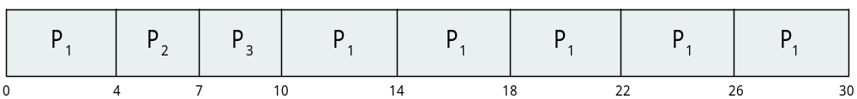
Example of RR with Time Quantum = 4
Consider the following three processes and their burst time
Process Burst Time
P₁ 24
P₂ 3
P₃ 3
The Gantt chart is:
The average waiting time under the RR policy is often longer
Typically, higher average turnaround than SJF, but better response
q should be large compared to context switch time
q is usually 10ms to 100ms, context switch < 10 usec

Slide 23

Time Quantum and Context Switch Time
The performance of the RR algorithm depends on the size of the time quantum. If the time quantum is extremely small (say, 1 millisecond), RR can result in a large number of context switches.

Slide 24

Turnaround Time Varies with the Time Quantum
The average turnaround time of a set of processes does not necessarily improve as the time-quantum size increases. In general, the average turnaround time can be improved if most processes finish their next CPU burst in a single time quantum.

Slide 25
Priority Scheduling
A priority number (integer) is associated with each process
The CPU is allocated to the process with the highest priority (smallest integer ≡ highest priority)
  Preemptive
  Non-preemptive
SJF is priority scheduling where priority is the inverse of predicted next CPU burst time
Problem ≡ Starvation – low priority processes may never execute
Solution ≡ Aging – as time progresses increase the priority of the process

Slide 26
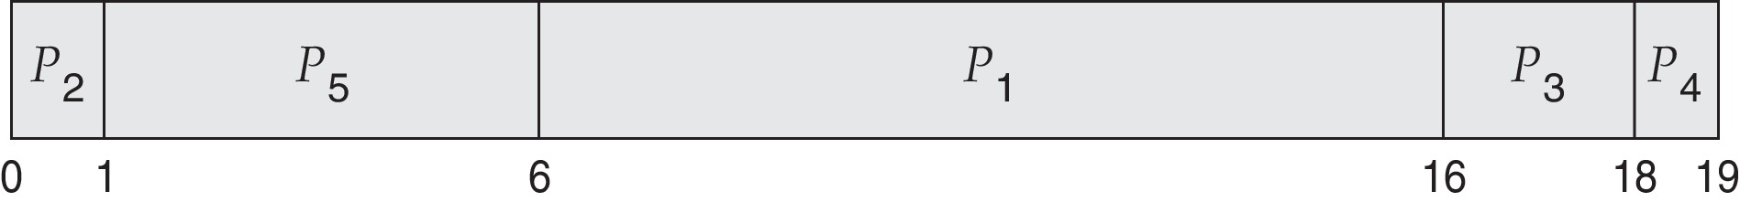
Example of Priority Scheduling
ProcessA arri Burst TimeT Priority
P₁ 10 3
P₂ 1 1
P₃ 2 4
P₄ 1 5
P₅ 5 2
Priority scheduling Gantt Chart
Average waiting time = 8.2 msec

Slide 27
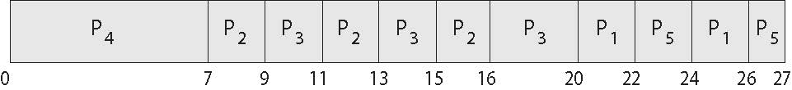
Combining Priority Scheduling and RR
System executes the highest priority process; processes with the same priority will be run using round-robin.
Consider the following five processes and their burst time
ProcessA arri Burst TimeT Priority
P₁ 4 3
P₂ 5 2
P₃ 8 2
P₄ 7 1
P₅ 3 3
Priority scheduling Gantt Chart
Average waiting time = 8.2 msec

Slide 28
Multilevel Queue
Ready queue is partitioned into separate queues, eg:
  foreground (interactive)
  background (batch)
Process permanently in a given queue
Each queue has its own scheduling algorithm:
  foreground – RR
  background – FCFS
Scheduling must be done between the queues:
  Fixed priority scheduling; (i.e., serve all from foreground then from background). Possibility of starvation.
  Time slice – each queue gets a certain amount of CPU time which it can schedule amongst its processes; i.e., 80% to foreground in RR
  20% to background in FCFS

Slide 29
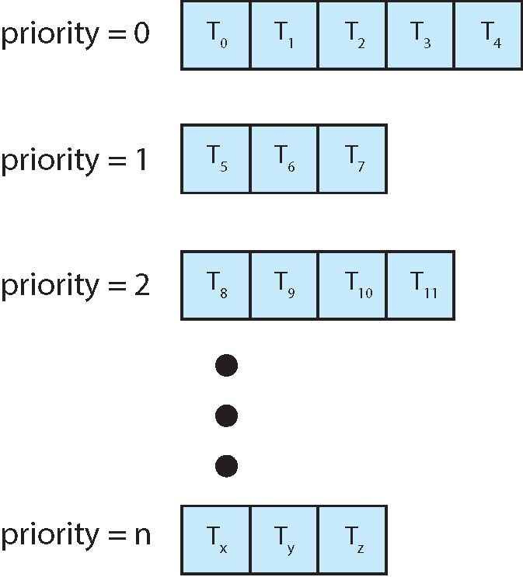
Separate Queue For Each Priority

Slide 30

Multilevel Queue Scheduling

Slide 31
Multilevel Feedback Queue
A process can move between the various queues; aging can be implemented this way
Multilevel-feedback-queue scheduler defined by the following parameters:
  number of queues
  scheduling algorithms for each queue
  method used to determine when to upgrade a process
  method used to determine when to demote a process
  method used to determine which queue a process will enter when that process needs service

Slide 32

Example of Multilevel Feedback Queue
Three queues:
  Q₀ – RR with time quantum 8 milliseconds
  Q₁ – RR time quantum 16 milliseconds
  Q₂ – FCFS
Scheduling
  A new job enters queue Q₀ which is served FCFS
    When it gains CPU, job receives 8 milliseconds
    If it does not finish in 8 milliseconds, job is moved to queue Q₁
  At Q₁ job is again served FCFS and receives 16 additional milliseconds
    If it still does not complete, it is preempted and moved to queue Q₂

Slide 33
End of Chapter 5a

